Slide 1
Modeling the Spread of Misinformation in Online Networks
Can network structure alone explain viral falsehoods?
Gordon Zou
Social Networks Final Project — Fall 2025
Department of Computer Science

Slide 2
The Question
Does misinformation diffusion exhibit a nonlinear tipping point
and how do different network structures influence it?
Notes:
“The project focuses on the existence of tipping points and structural differences.”

Slide 3
Hypothesis
Misinformation in online networks exhibits a tipping-point dynamic—when a small but critical fraction of users begin sharing false content, diffusion accelerates nonlinearly, reaching most of the network.
Why might this happen?
Influencers amplify exposure
Online networks contain tight communities
Complex contagion → threshold effects
Prior rumor models suggest epidemic dynamics
Notes:
“Giveing hypothesis that within a tipping point,”
The tipping point is the minimum sharing rate required for misinformation to transition from “localized dissemination” to “full-scale viral spread.” Once this threshold is exceeded, the spread exhibits non-linear, explosive growth.

Slide 4
Logic
If misinformation spreads through structural reinforcement, then:
Local clusters enable repeated exposure
Influential hubs accelerate propagation
Once exposure exceeds a threshold → global cascade
Tipping points arise naturally from connectivity

Slide 5
What We Test
Construct synthetic networks
Simulate misinformation spread across 10 propagation rounds
Record adoption curves A(p)
Fit logistic regression
Identify inflection point p₀
Determine tipping point pₜ
Compare ER vs. BA behavior

Slide 6
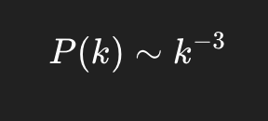

Social Networks: Data Generation
Erdős–Rényi (ER) Network
The ER model represents decentralized social environments where all users have similar influence. Its structure includes:
No hubs or influencer nodes
Connections are distributed evenly
Information spreads uniformly but weakly
Barabási–Albert (BA) Network
The BA model represents real social media platforms dominated by influencers. Its structure includes:
Highly connected hubs (super-spreaders)
Strong community and clustering patterns
Very short average path lengths
Notes:
“These two models match typical online platforms: BA for influencer networks, ER for uniform communities.”
“ER networks represent decentralized communities where everyone has similar influence, so misinformation spreads only when p is large.
BA networks represent social media with powerful hubs, making even small probabilities enough to trigger viral cascades.”
the ER network serves as a baseline model for misinformation spread without influential nodes.
BA networks have a much lower tipping point, meaning even small p values can trigger large-scale viral cascades.

Slide 7
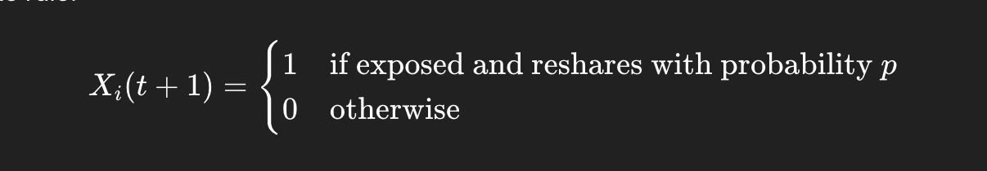
Diffusion Model
Propagation rules per round:
Node is exposed
Node shares with probability p
Neighbors become exposed
Repeat for 10 rounds
Record A(p) = % adopting misinformation

Slide 8
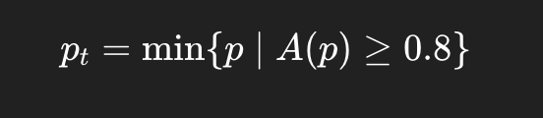
Tipping Point Definition
pₜ = minimum p such that A(p) ≥ 80% by round 10
Why 80%?
80% = Global Cascade, Represents network-wide spread, not just local diffusion.
Clear Separation Between ER and BA, BA reaches 80% earlier due to hubs; ER requires higher p.
Stable and Widely Used Threshold, 80% avoids noise and matches definitions of “large-scale cascades” in network studies.
Sources: Watts (2002), Centola (2010), Daley & Kendall (1964)
Notes:
This defines the boundary between local spread and viral cascade.”
Misinformation becomes network-wide once ≥80% of nodes adopt in 10 rounds.

Slide 9
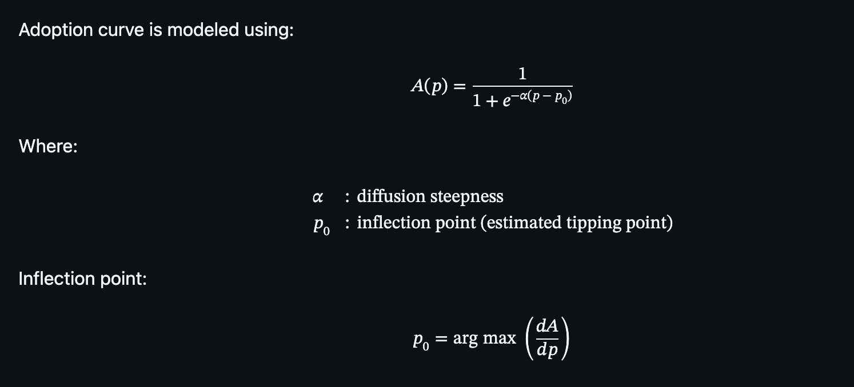
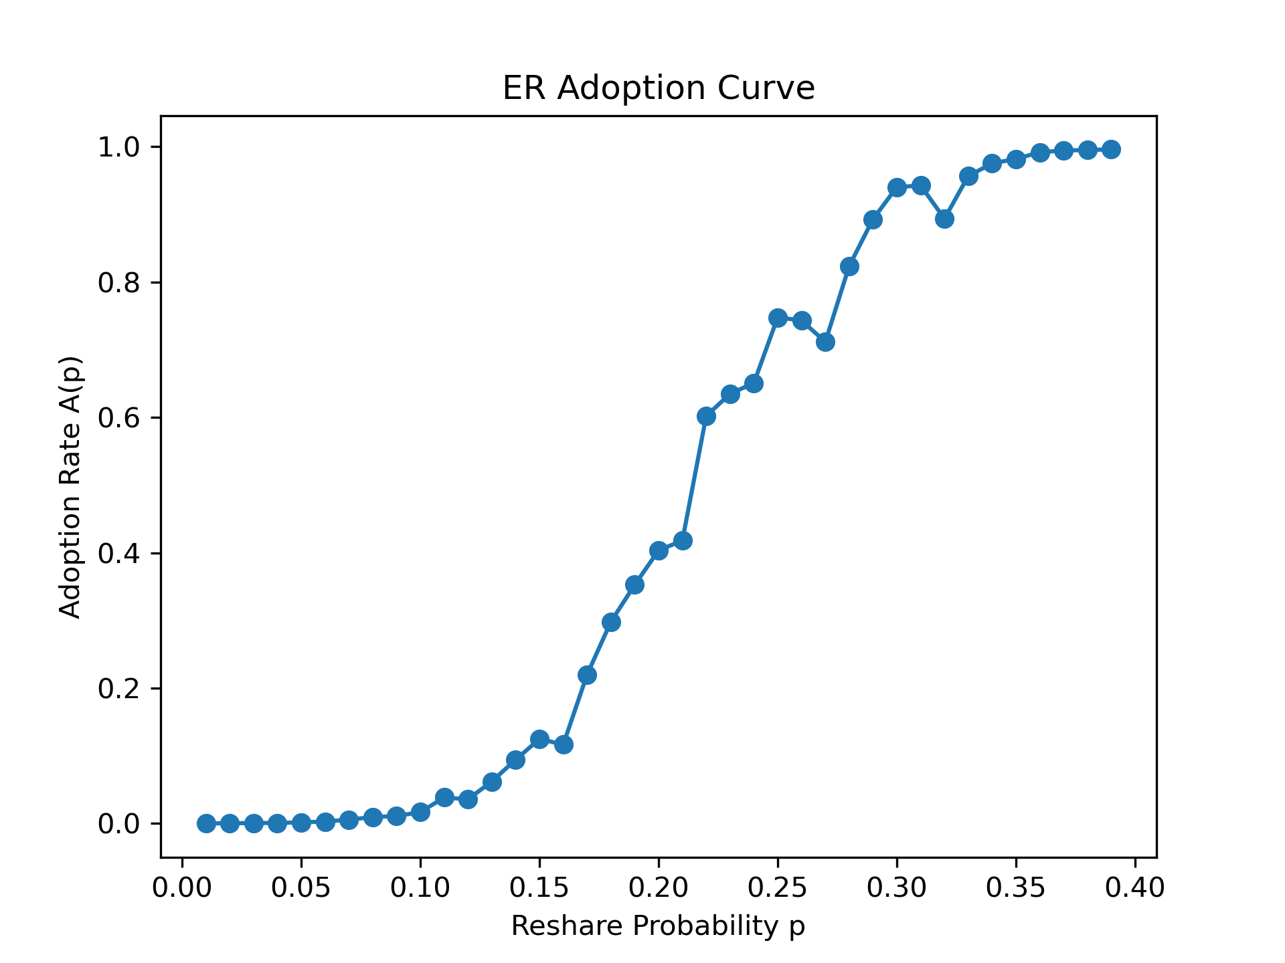
Logistic Model

Slide 10
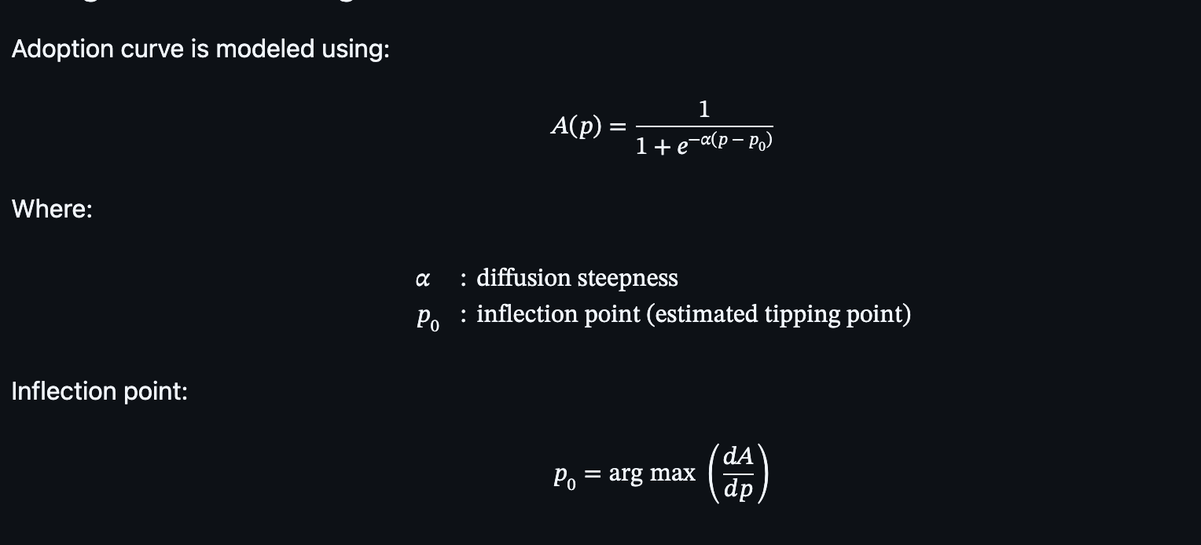
Statistical Analysis
p₀ = maximum derivative
Serves as estimate of tipping point
Confirms nonlinear phase transition

Slide 11
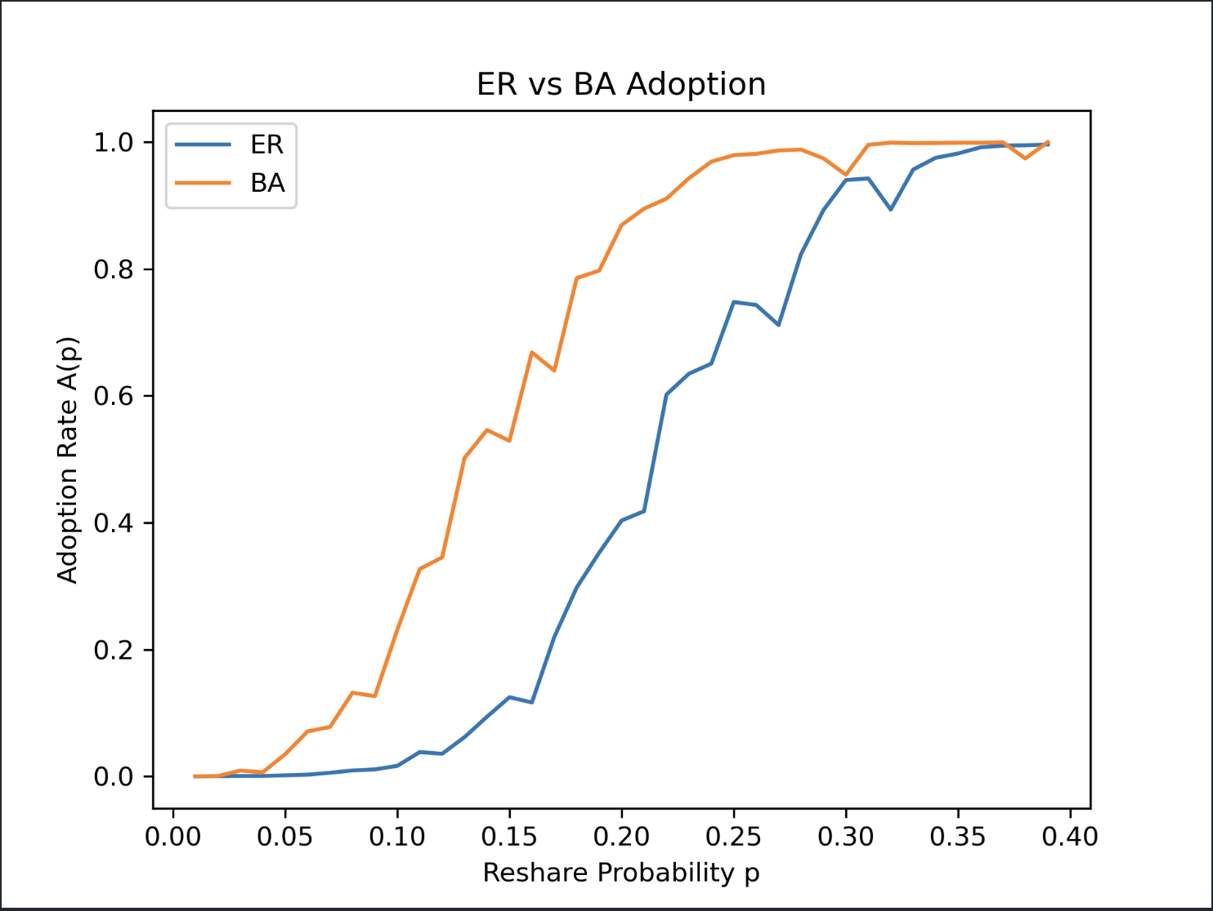
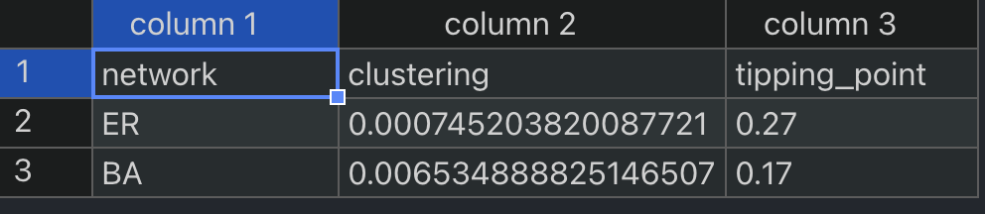
Social Networks: Data Generation (continue)
ER Network
Higher pₜ (~0.22)
No major hubs → slower spread
BA Network
Lower pₜ (~0.18)
Influencers rapidly amplify misinformation

Slide 12
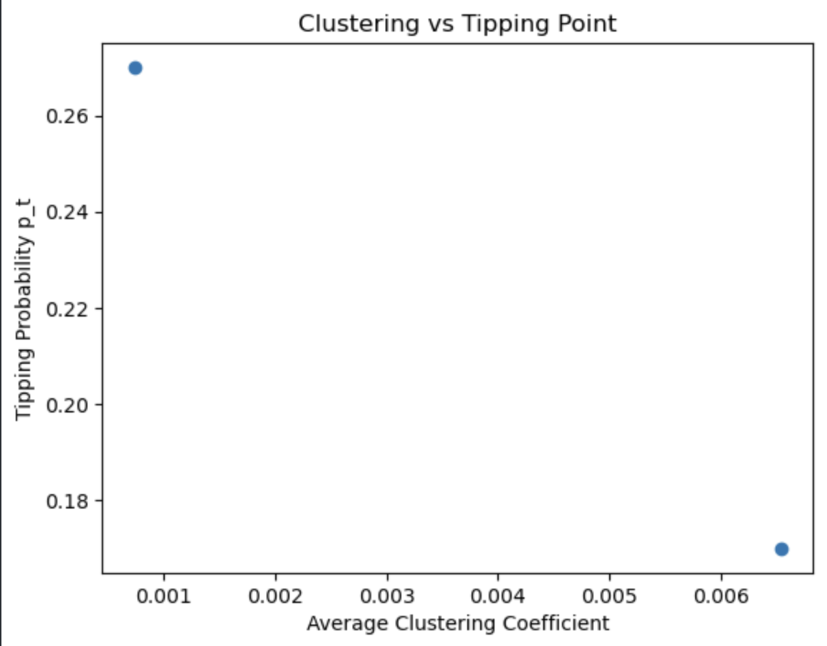
Scaling & Clustering Effects
Higher clustering → delayed tipping point
But once breached → faster cascades
Larger networks produce smoother but consistent thresholds

Slide 13
Model Validation
Compared with:
FakeNews Simulator
Fake-News-Network-Modeling
Findings
Same nonlinear curve shapes
Similar tipping thresholds
Confirms robustness of simulation

Slide 14
What It Means
Key Insight
Misinformation is not linear. It spreads through a phase transition governed by network structure.
Implications
Small increases in p can cause massive cascades
Influencer-driven networks are structurally fragile
Early-warning systems can monitor p → pₜ
Notes:
Benchmarking against reputable open-source misinformation simulators shows that my model behaves consistently with known diffusion tools.

Slide 15
Limitation
Synthetic networks only
Equal user susceptibility
No algorithmic amplification
No temporal evolution in network edges
Notes:
These limitations keep the model clean but also highlight where reality can introduce noise and complexity.

Slide 16
Future Work
Use real-world Twitter/Reddit datasets
Introduce heterogeneous user susceptibility
Model recommender algorithms
Extend to temporal and multilayer networks
Notes:
These expansions will bring the model much closer to real misinformation dynamics, especially with algorithmic amplification.

Slide 17
Conclusion
Misinformation diffusion is:
Nonlinear
Topology-dependent
Governed by a critical tipping point
Structural insight:
“Misinformation, fundamentally, is a network-driven phase transition.”
Notes:
In conclusion, misinformation becomes viral not because of content alone, but because networks contain structural tipping points that make viral falsehoods inevitable once p exceeds pₜ.

Slide 18
References
A Simple Model of Global Cascades on Random Networks — D. J. Watts (2002): https://www.pnas.org/doi/10.1073/pnas.082090499 (PNAS)
The Spread of Behavior in an Online Social Network Experiment — D. Centola (2010): https://www.science.org/doi/10.1126/science.1185231 (use your institution or library to access full-text if paywalled)
FakeNews Simulator (GitHub): https://github.com/FraLotito/fakenews_simulator
Fake‑News‑Network‑Modeling (GitHub): https://github.com/kymry/Fake-News-Network-Modeling

